Slide 1
Autism and Community Participation
Presented by: Meghan Dworschak
The George Washington University

Slide 2
What is Community Participation?
Participation is the act of taking part in or doing something
So, Community Participation is when you take part in something within your community

Slide 3
Recreation and Leisure
Today, I want to talk to you about participating in recreation and leisure activities within in your community
“Leisure participation for children and youth can be defined as involvement in formal and informal everyday voluntary activities of childhood performed in all types of environments (Askari et al., 2015) ”.
In other words, this means anything you do for fun!

Slide 4

Why is this important?
Participating in activities for enjoyment, or fun, are important for our health, well-being, and overall quality of life!
Basically…it’s good for your body and makes you happier
We get even better benefits from activities that keep us active (think sports), and when we do activities with other people in our community
This Photo by Unknown Author is licensed under CC BY-NC-SA
Notes:
NOTE: To change images on this slide, select a picture and delete it. Then click the Insert Picture icon in the placeholder to insert your own image.

Slide 5

What does Autism have to do with it?!?
Individuals with High Functioning Autism (HFA) or Asperger’s are less likely to participate in recreation and leisure activities when compared to other people. This is especially true for activities that require physical activity
Youth with HFA are more likely to participate in leisure activities such as playing video games or watching TV by themselves or with family in their own home, instead of doing active things in the community with other peers or friends
More physical activity & interacting with others in the community
=
a better, healthier, happier YOU!
(Askari, et al., 2015; Carter, et al., 2013; Must et al., 2015; Myers, et al., 2015; Obrusnikova, & Miccinello, 2012; Potvin, et al., 2008; Shattuck, et al., 2011)

Slide 6
What does this mean for me?
It’s important for youth with High Functioning Autism (HFA) to participate with peers in leisure activities, such as joining a youth group or playing team sports, in order to “develop skills and capabilities; form meaningful relationships; achieve mental and physical health; express their creativity and enjoyment; develop self-identity, self-esteem, and emotional well-being; and achieve purpose and meaning in their lives” (Askari et al., 2015).
Although participation in recreation activities benefits all people, it provides even greater benefits for individuals with autism-like you- who might find it challenging to control behaviors and emotions, make and keep friends, stay fit and healthy, have energy and stay focused, and make decisions for yourself on what you like and don’t like to do (Potvin et al., 2008).

Slide 7
Barriers to Community Participation
A barrier is something that makes an activity hard to do

Slide 8
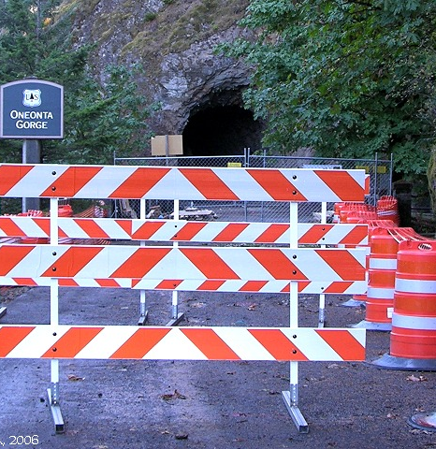
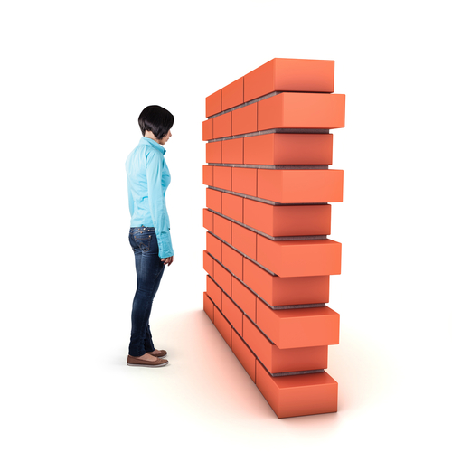
Although all youth face some types of barriers to participation in recreation and leisure activities within their community, individuals with autism have to deal with more barriers that are harder to handle
Notes:
NOTE: To change images on this slide, select a picture and delete it. Then click the Insert Picture icon in the placeholder to insert your own image.

Slide 9
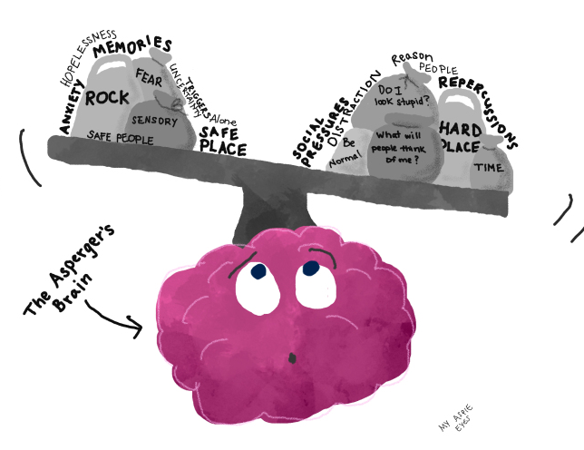
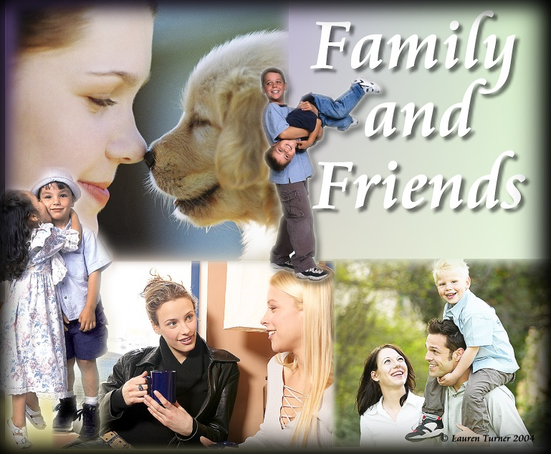
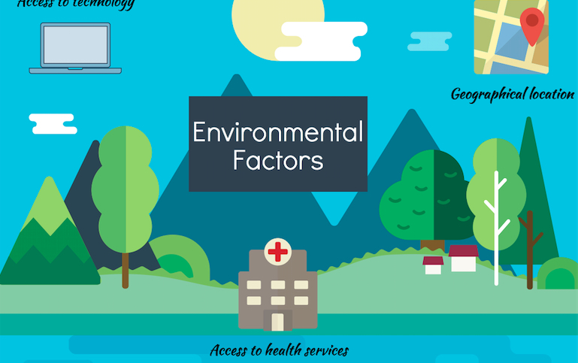
There are 3 types of barriers that make participating more challenging.
This Photo by Unknown Author is licensed under CC BY
Child-level (my personal challenges), Family and Peer-level (challenges that my family and friends have), Environmental-level (challenges presented to me by my environment)
(Must et al., 2015; Obrusnikova & Miccinello, 2012; Potvin et al., 2018)

Slide 10
Child-Level Barriers
      Difficulty understanding other people’s words and actions and expressing yourself to others
      Being sensitive to things in the environment, making it hard or unpleasant to do certain activities (examples: sensitivity to certain smells, sounds, sights, textures)
      Some movements are difficult, causing challenges for physical participation in activities-especially sports or other physical activities
      Hard to focus on activities for extended periods of time
      Not motivated enough or don’t want to participate in certain activities with others
      Lack of time or energy due to other demands (e.g., therapies, tutoring, being tired from extra effort it takes to do daily activities)
      Difficulty controlling behavior and/or emotions
      Might not have the skills to do certain things independently or feels uncomfortable doing things without some help or encouragement
      Not always aware of everything going on around you, making it hard to stay safe
      Only like doing certain activities (maybe you only like watching TV/videos and nothing else)
      Don’t completely understand your disability and how it affects you
      Afraid of what other people think of you/ feel like you don’t fit in
(Askari et al., 2015; Liptak et al. 2011; Must et al., 2015; Myers et al., 2015; Obrusnikova & Miccinello, 2012; Potvin et al., 2008;).

Slide 11
Family and Peer-Level Barriers
      Family life is too busy
      Activities that are appropriate for you and interesting to you cost too much
      Transportation is not always available
      There aren’t enough available activities that you like that your peers also like
      The focus is on school and academics instead of on recreation and leisure
      Parents/Guardians are not available to support you during activities
      Family is too tired to participate in/attend recreation and leisure activities
      Other people might not completely understand your disability; including abilities and challenges
      Other people might set low expectations for you because they don’t understand your disability
      Other people might not support you the way you need or speak up for you because they don’t know what you need or it’s too hard for them
(Askari et al., 2015; Kramer et al., 2011; Liptak et al. 2011; Must et al., 2015; Myers et al., 2015; Potvin et al., 2008; Obrusnikova & Miccinello, 2012).

Slide 12
Environmental-Level Barriers
      The environment might be difficult or unpleasant for you for certain activities due to sensory sensitivities. Some examples:
          Crowded areas with too many people
          Loud or annoying noises
          Being outdoors (temperature outside, possibility of bad weather, bugs)
          Physical activity like running, playing sports, or things that make you move too much
          Being inside and sitting still or being quiet
          Certain smells
          Certain sights like bright or flashing lights
      Lack of appropriate equipment, assistive technology, or accommodations that you might need to be successful while participating in certain activities that are challenging for you, especially for physically active options
      You/your family don’t know the activities or supports that are available to you in your community
      There aren’t enough programs and resources available that are age and ability appropriate that you like
      Sometimes the people offering activities are not aware of your disability or your needs
      Sometimes other people treat you/think of you differently because of your disability
      Lack of available transportation options in the community
(Askari et al., 2015; Kramer et al., 2011; Must et al., 2015; Potvin et al., 2008; Obrusnikova & Miccinello, 2012).

Slide 13
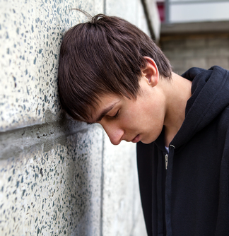
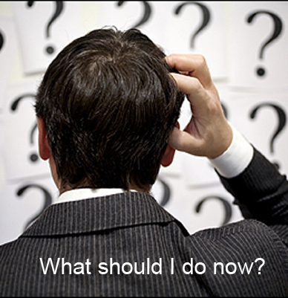
You might be thinking, “OK, now what? Can I do something about it?”

Slide 14

Overcoming Barriers

Slide 15
How To Overcome:
Child-Level Barriers (my personal challenges)
    You can ask your teacher to help you learn and practice social skills and leisure skills with peers
    You can find out what it means to be an active citizen in your community and practice doing it
    The earlier you begin experiencing and practicing different leisure skills with others, the better!
    You can volunteer more in your community. Do different things each time and rack up those SSL hours! Trying more things will help you determine your preferences. You’ll never know until you try it.
    You can ask for assistance to build and maintain friendships with others. It takes a lot of listening and learning how to compromise.
    You can participate in your IEP planning process and make sure your team is working to support you with a plan designed just for you to help you be an active community member. Tell people what you want to work on or what supports are helpful for you
    You can use your strengths and interests to help you determine activities that will be good for you
    You can advocate for yourself and tell other people what you like and don’t like
    You can ask an adult to help you do a community mapping exercise to identify available opportunities and resources in your specific community
    You can learn how to and practice accessing resources in your community (example: learn how to use public transportation or what you need to do to get a driver’s license)
(Askari et al., 2015; Carter et al., 2013; Kramer et al., 2011; Liptak et al. 2011; Obrusnikova & Miccinello, 2012; Shattuck et al., 2011)

Slide 16
How To Overcome:
Family & Peer-Level Barriers (challenges that my family & friends have)
    They can ask you for you input on your interests, preferences, and needs
    They can help you complete community mapping exercises to identify available opportunities and resources in your community
    They can help you make a plan to try out different recreation, leisure, and volunteer activities based on your interests
    They can provide more support and advocate for/help you advocate for your needs
    They can increase the amount of attention given to recreation and leisure skills and opportunities
    They can help you learn and practice skills you need to be more independent in the community (e.g., social skills, daily living skills, & leisure skills)
    They can encourage you/help you get a part-time job so you use your own money to pay for things you want
    They can help you search for activities that are free/low cost or for resources that will help you pay for more expensive ones
    They can attend trainings or do other things to learn more about your disability and how to support you
    They can research transportation options in your community and help you access them
    They can ask other people for help and seek out trainings to help teach you the skills you need
    They can set high expectations for you!
(Askari et al., 2015; Carter et al., 2013; Kramer et al., 2011; Liptak et al. 2011; Obrusnikova & Miccinello, 2012; Shattuck et al., 2011)

Slide 17
How To Overcome:
Environmental-Level Barriers (challenges presented to me by my environment)
    YOU AND YOUR FAMILY CAN:
    Advocate for more individualized supports and strategies to help you and your family
    Advocate for more information on available programs, supports, and resources for a range of activities
    Advocate for more specialized training to people who support you and your family
    Advocate for more opportunities for others to learn more about your disability
    Advocate to make changes to your environment or activities to help you participate when possible
    Advocate for accommodations to help you with any sensory challenges (example: ask for headphones in a loud environment)
    Advocate for more structured routines and schedules for recreation and leisure activities
    Advocate for more age-appropriate activities that are inclusive. This means that you are participating in the community with peers your age, who may or may not have disabilities
(Askari et al., 2015; Carter et al., 2013; Liptak et al., 2015; Must et al., 2015; Obrusnikova & Miccinello, 2012; Shattuck et al., 2011 )

Slide 18

You spoke, I listened!
This Photo by Unknown Author is licensed under CC BY-NC-SA

Slide 19
In Your Own Words…Biggest Barriers
Your Top 5
Not enough time
Difficulty controlling behaviors and emotions
Fear of what others think/I don’t feel like I “fit in”
Lack of transportation
I don’t know/don’t like what’s available to me or I don’t have peers interested in doing the same things with me

Slide 20
In Your Own Words…What Will Help?
Your Top 5
Increase disability awareness in my community
Add more options of interest
Need more support from family/friends
Include technology/ electronics in activities
Need more information on available options

Slide 21
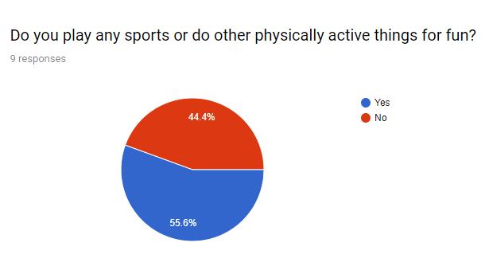
Remember: More physical activity & interacting with others in the community
= a better, healthier, happier YOU!
A little more than half said “yes” you do physically active things for fun
Only 2 have played on an organized sports team within the last 5 years
Others enjoyed martial arts and working out at the gym.
Most said you liked to do activities at home by yourself not in the community with others
Also mentioned: hanging out with friends and family, going to sporting events and amusement parks, going to the mall, going on vacations, cosplay, writing, and drawing

Slide 22
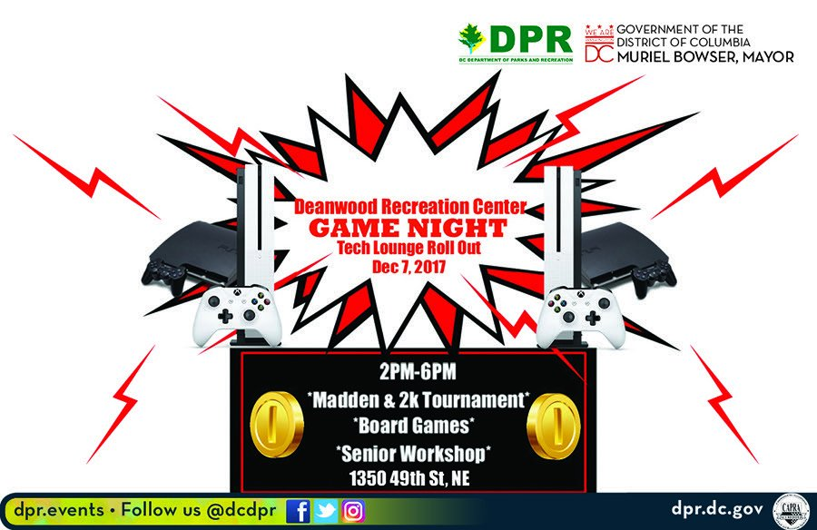




Recreation and Leisure Activities of Interest In Your Community!!
Martial Arts
Video Gaming
Reading
Workshops for Drawing, Comics, Animation, and more
Inclusive activities of your choice. Almost unlimited options!!
Notes:
NOTE: To change images on this slide, select a picture and delete it. Then click the Insert Picture icon in the placeholder to insert your own image.

Slide 23
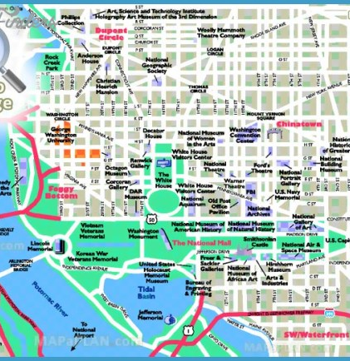
Let’s look at more information on programs and resources in your community
Resource Guide
to
Recreation and Leisure
in the DMV for Youth with HFA
Link to Community Map
Link to Resource Guide

Slide 24
Resources
Askari, S., Anaby, D., Bergthorson, M., Majnemer, A., Elsabbagh, M., & Zwaigenbaum, L. (2015). Participation of children and youth with autism spectrum disorder: a scoping review. Review Journal of Autism and Developmental Disorders. 2(1), 103- 114. doi: 10.1007/s40489-014-0040-7
Carter, E. W., Harvey, M. N., Taylor, J. L., & Gotham, K. (2013). Connecting youth and young adults with autism spectrum disorders to community life. Psychology in the Schools, 50(9), 888-898. doi: 10.1002/pits.21716
Kramer, J., Olsen, S., Mermelstein, M., Balcells, A., & Liljenquist, K. (2011). Youth with disabilities’ perspectives of the environment and participation: a qualitative meta-synthesis. Child: care, health and development, 38 (6), 763–777. doi:10.1111/j.1365-2214.2012.01365.x
Liptak, G.S., Kennedy, J.A., & Dosa, N.P. (2011). Social participation in a nationally representative sample of older youth and young adults with autism. Journal of Developmental & Behavioral Pediatrics, 32(4), 277.283. doi: 10.1097/DBP.0b013e31820b49fc
Must, A., Phillips, S., Curtin, C., & Bandini, L. (2015). Barriers to physical activity in children with autism spectrum disorders: Relationship to physical activity and screen time. Journal of Physical Activity and Health, 12, 529-534. http://dx.doi.org/10.1123/jpah.2013-0271

Slide 25
Resources Continued…
Myers, E., Davis, B. E., Stobbe, G., & Bjornson, K. (2015). Community and social participation among individuals with autism spectrum disorder transitioning to adulthood. Journal of Autism and Developmental Disorders, 45(8), 2373-2381. doi: 10/1077/s10803-015-2403-z
Obrusnikova, I., & Miccinello, D. (2012). Parent perceptions of factors influencing after-school physical activity of children with autism spectrum disorders. Adapted Physical Activity Quarterly, 29 (1), 63-80. https://doi.org/10.1123/apaq.29.1.63
Orsmond, G. I., Shattuck, P. T., Cooper, B. P., Sterzing, P. R., & Anderson, K. A. (2013). Social participation among young adults with an autism spectrum disorder. Journal of Autism and Developmental Disorders, 43(11), 2710-2719. doi: 10/1007/s10803-013-1833-8
Potvin, M., Prelock, P., & Snider, L. (2008). Collaborating to support meaningful participation in recreational activities of children with autism spectrum disorder. Topics in Language Disorders, 28(4), 365-374. doi: 10.1097/01.TLD.0000341129.01158.bb
Roux, A. M., Shattuck, P. T., Rast, J. E., Rava, J. A., & Anderson, K. A. (2015). National autism indicators report: Transition into young adulthood. Retrieved from http://drexel.edu/autismoutcomes/publications-and-reports/nat-autism-indicators-report/
Shattuck, P. T., Orsmond, G. I., Wagner, M., & Cooper, B. P. (2011). Participation in social activities among adolescents with an autism spectrum disorder. PloS One, 6(11), e27176. doi: 10.1371/journal.pone.00271767

Slide 26

Any Questions??

